Slide 1

A school-wide advisory plan for Skeena Middle School
Kelsey Wiebe

Slide 2
advisory at Skeena Middle School
Current Situation
Intentions Around Advisory
A New Vision for Advisory
Monday Advisory Plans
Wednesday Advisory Plans
Friday Advisory Plans
Troubleshooting Challenges
Resources
Review

Slide 3
Skeena Middle School: Current situation
Advisory was never clearly defined. Students and teachers alike are unsure of its purpose.
There are very few resources available, and no program that is used across the school for social-emotional learning. Instead, everyone uses their own approach, with varying degrees of success.
Without a clear focus, and without access to resources, both teachers and students treat advisory as a throwaway block.
Students skip advisory with little penalty as no attendance is reported to the office. Students hide in the bathrooms and wander the halls.
Some teachers do social-emotional learning in advisory. Some work on community-building. Some go to the gym or outside. Some do nothing.

Slide 4
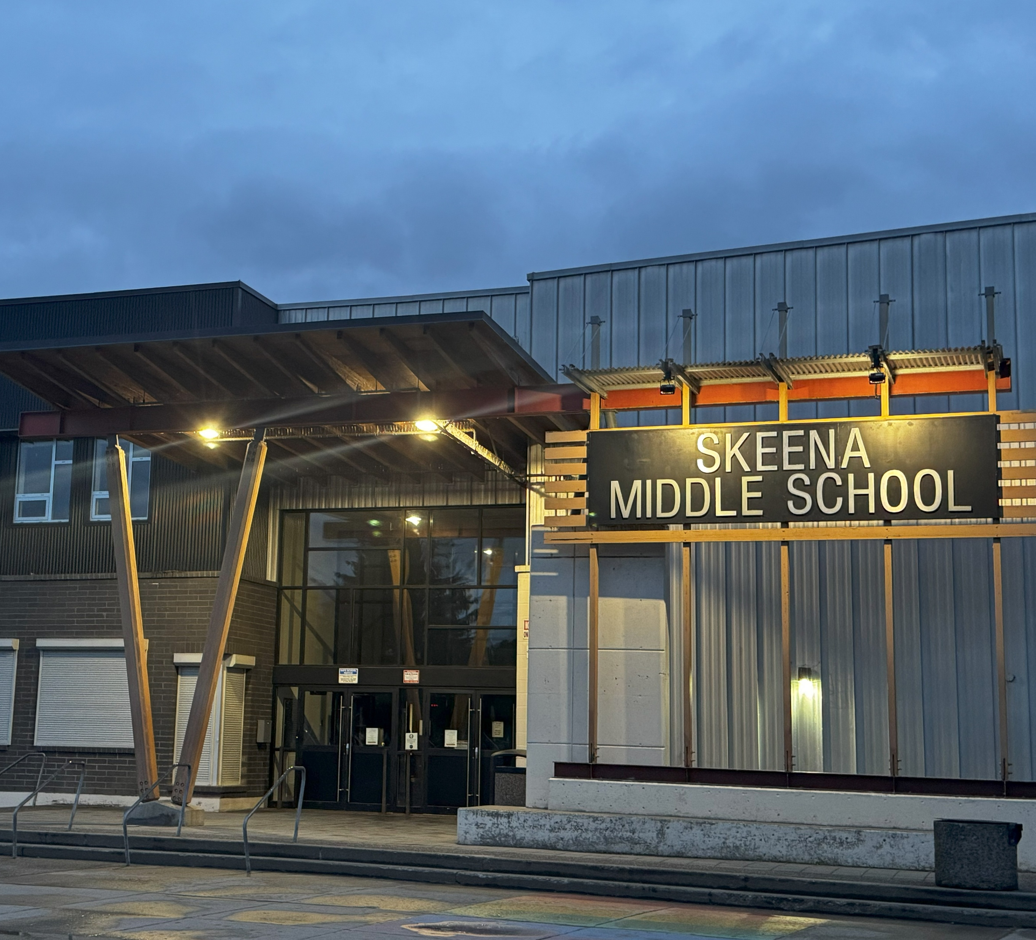
Intentions around advisory
Our principal worked with Leyton Schnellert to plan to situate our school more as a middle school (it was previously a junior high)
Our principal has stated that advisory was meant to allow students to develop relationships with an adult in the school other than their classroom teacher. This makes sense for grade 7/8, which are set up with a core teacher. It makes less sense for grade 9, where students have up to 8 teachers
Our principal has told us many times that advisory is non-negotiable

Slide 5
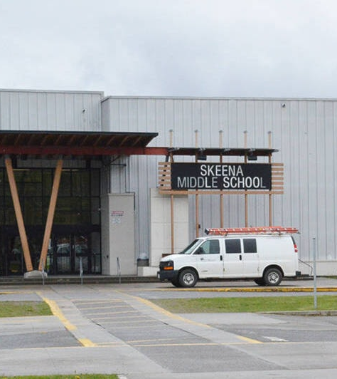
A New vision for advisory
We need to coordinate together as a whole school to get on the same page about a vision for advisory
We have a great need for social-emotional learning, with many students disconnected from school and friends, and with serious incidences of bullying, online and at school
We need desperately to promote community in advisory, to make connections with and between students, and to encourage students to engage with and develop social-emotional skills
Having a schoolwide structure that standardizes advisory but still allows individual teachers to apply their own ideas, values, and interests will help develop a sense of community
We have advisory three times a week (Monday, Wednesday, Friday) for half an hour

Slide 6
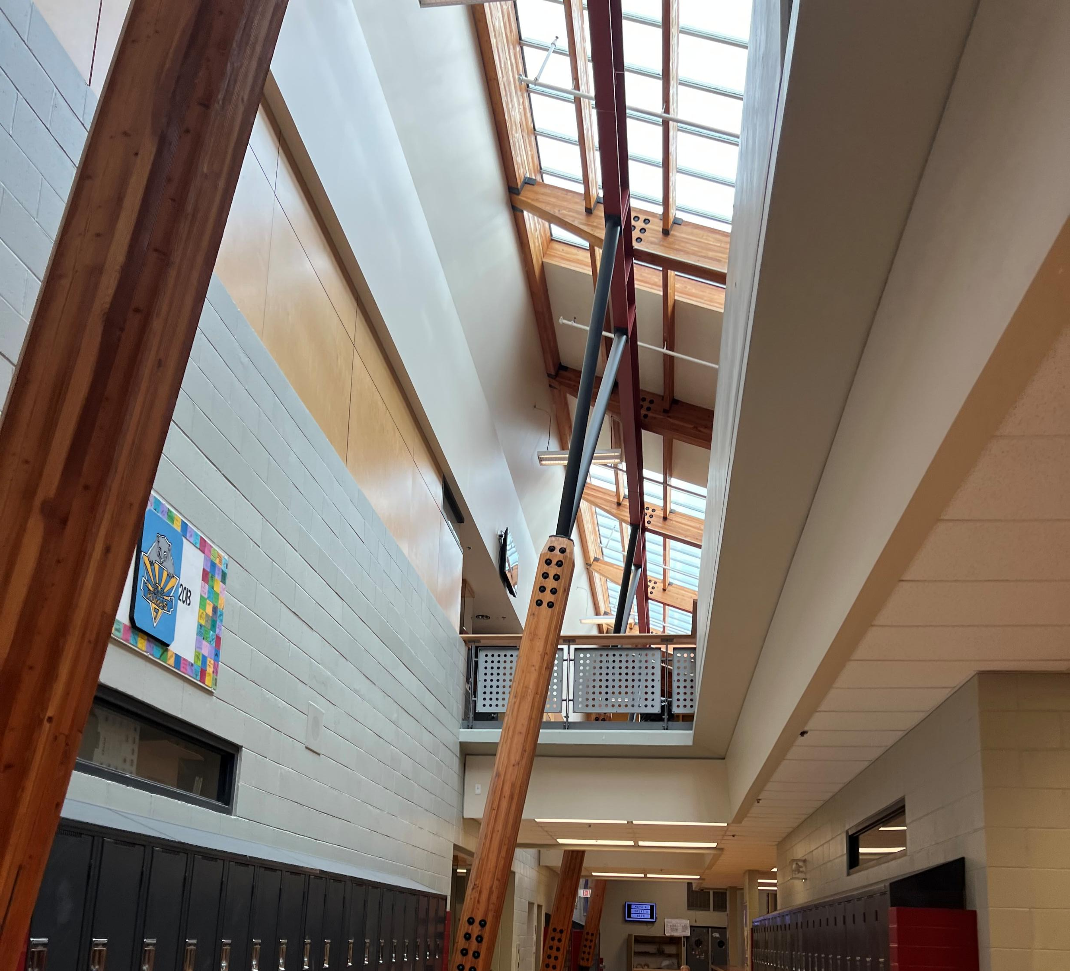
Monday advisory plans
Monday advisory will be structured around circles
Teachers should run a circle to get to know the students, build connections and community, and discuss and share ideas about issues impacting students
Issues might include bullying, social media, phone usage, school discipline policies, school events, community events, community issues, grades vs. the proficiency scale, etc.
Teachers will spend time building expectations for the circle and building students’ comfort and safety with the circle format and with one another
Circles may be broadly interpreted, and teachers will run their circles according to what works for them and their classes

Slide 7
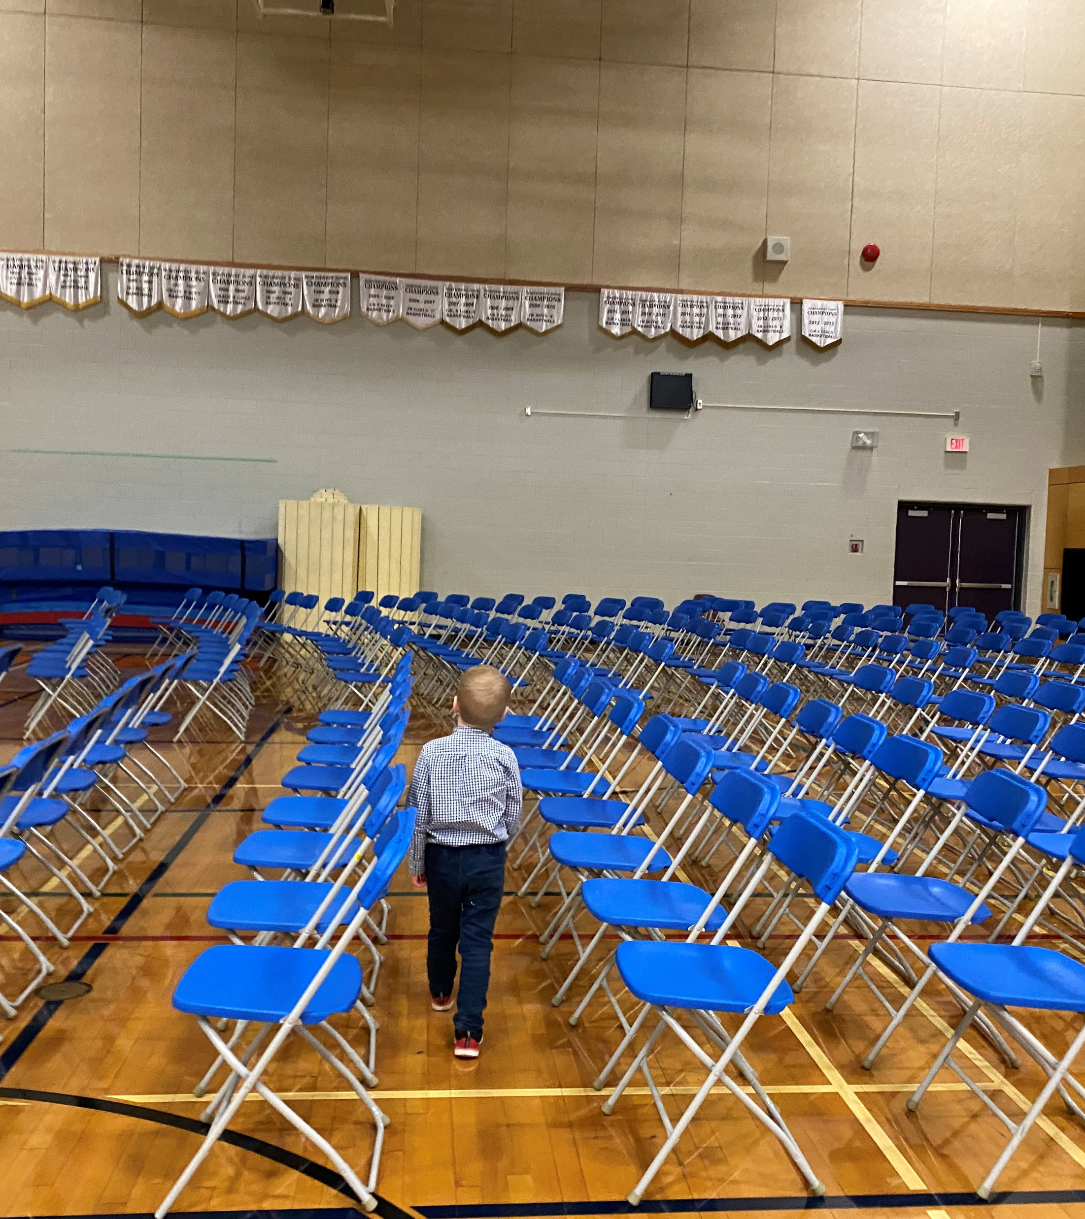
Wednesday advisory plans
On Wednesdays, students will participate in a school-wide mentorship program
Mentoring will be fluid: students will mentor same-age or younger peers academically and socially
Peer tutoring program with students who want additional academic support
Peer counselling program with students who receive mediation and counselling training to help mediate peer and social-emotional challenges
Students are especially willing to listen to and learn from older peers, so this is an excellent opportunity to effect change in ongoing challenges of racism, sexism, homophobia, and transphobia at our school
Guest teaching opportunities for students to share their interests, ideas, and experiences
Coaching opportunities for athletic students to mentor younger students in specific skills
There should be as much choice as possible
The openness and diversity of the mentoring program will allow all students’ needs, interests, and capabilities to be honoured

Slide 8
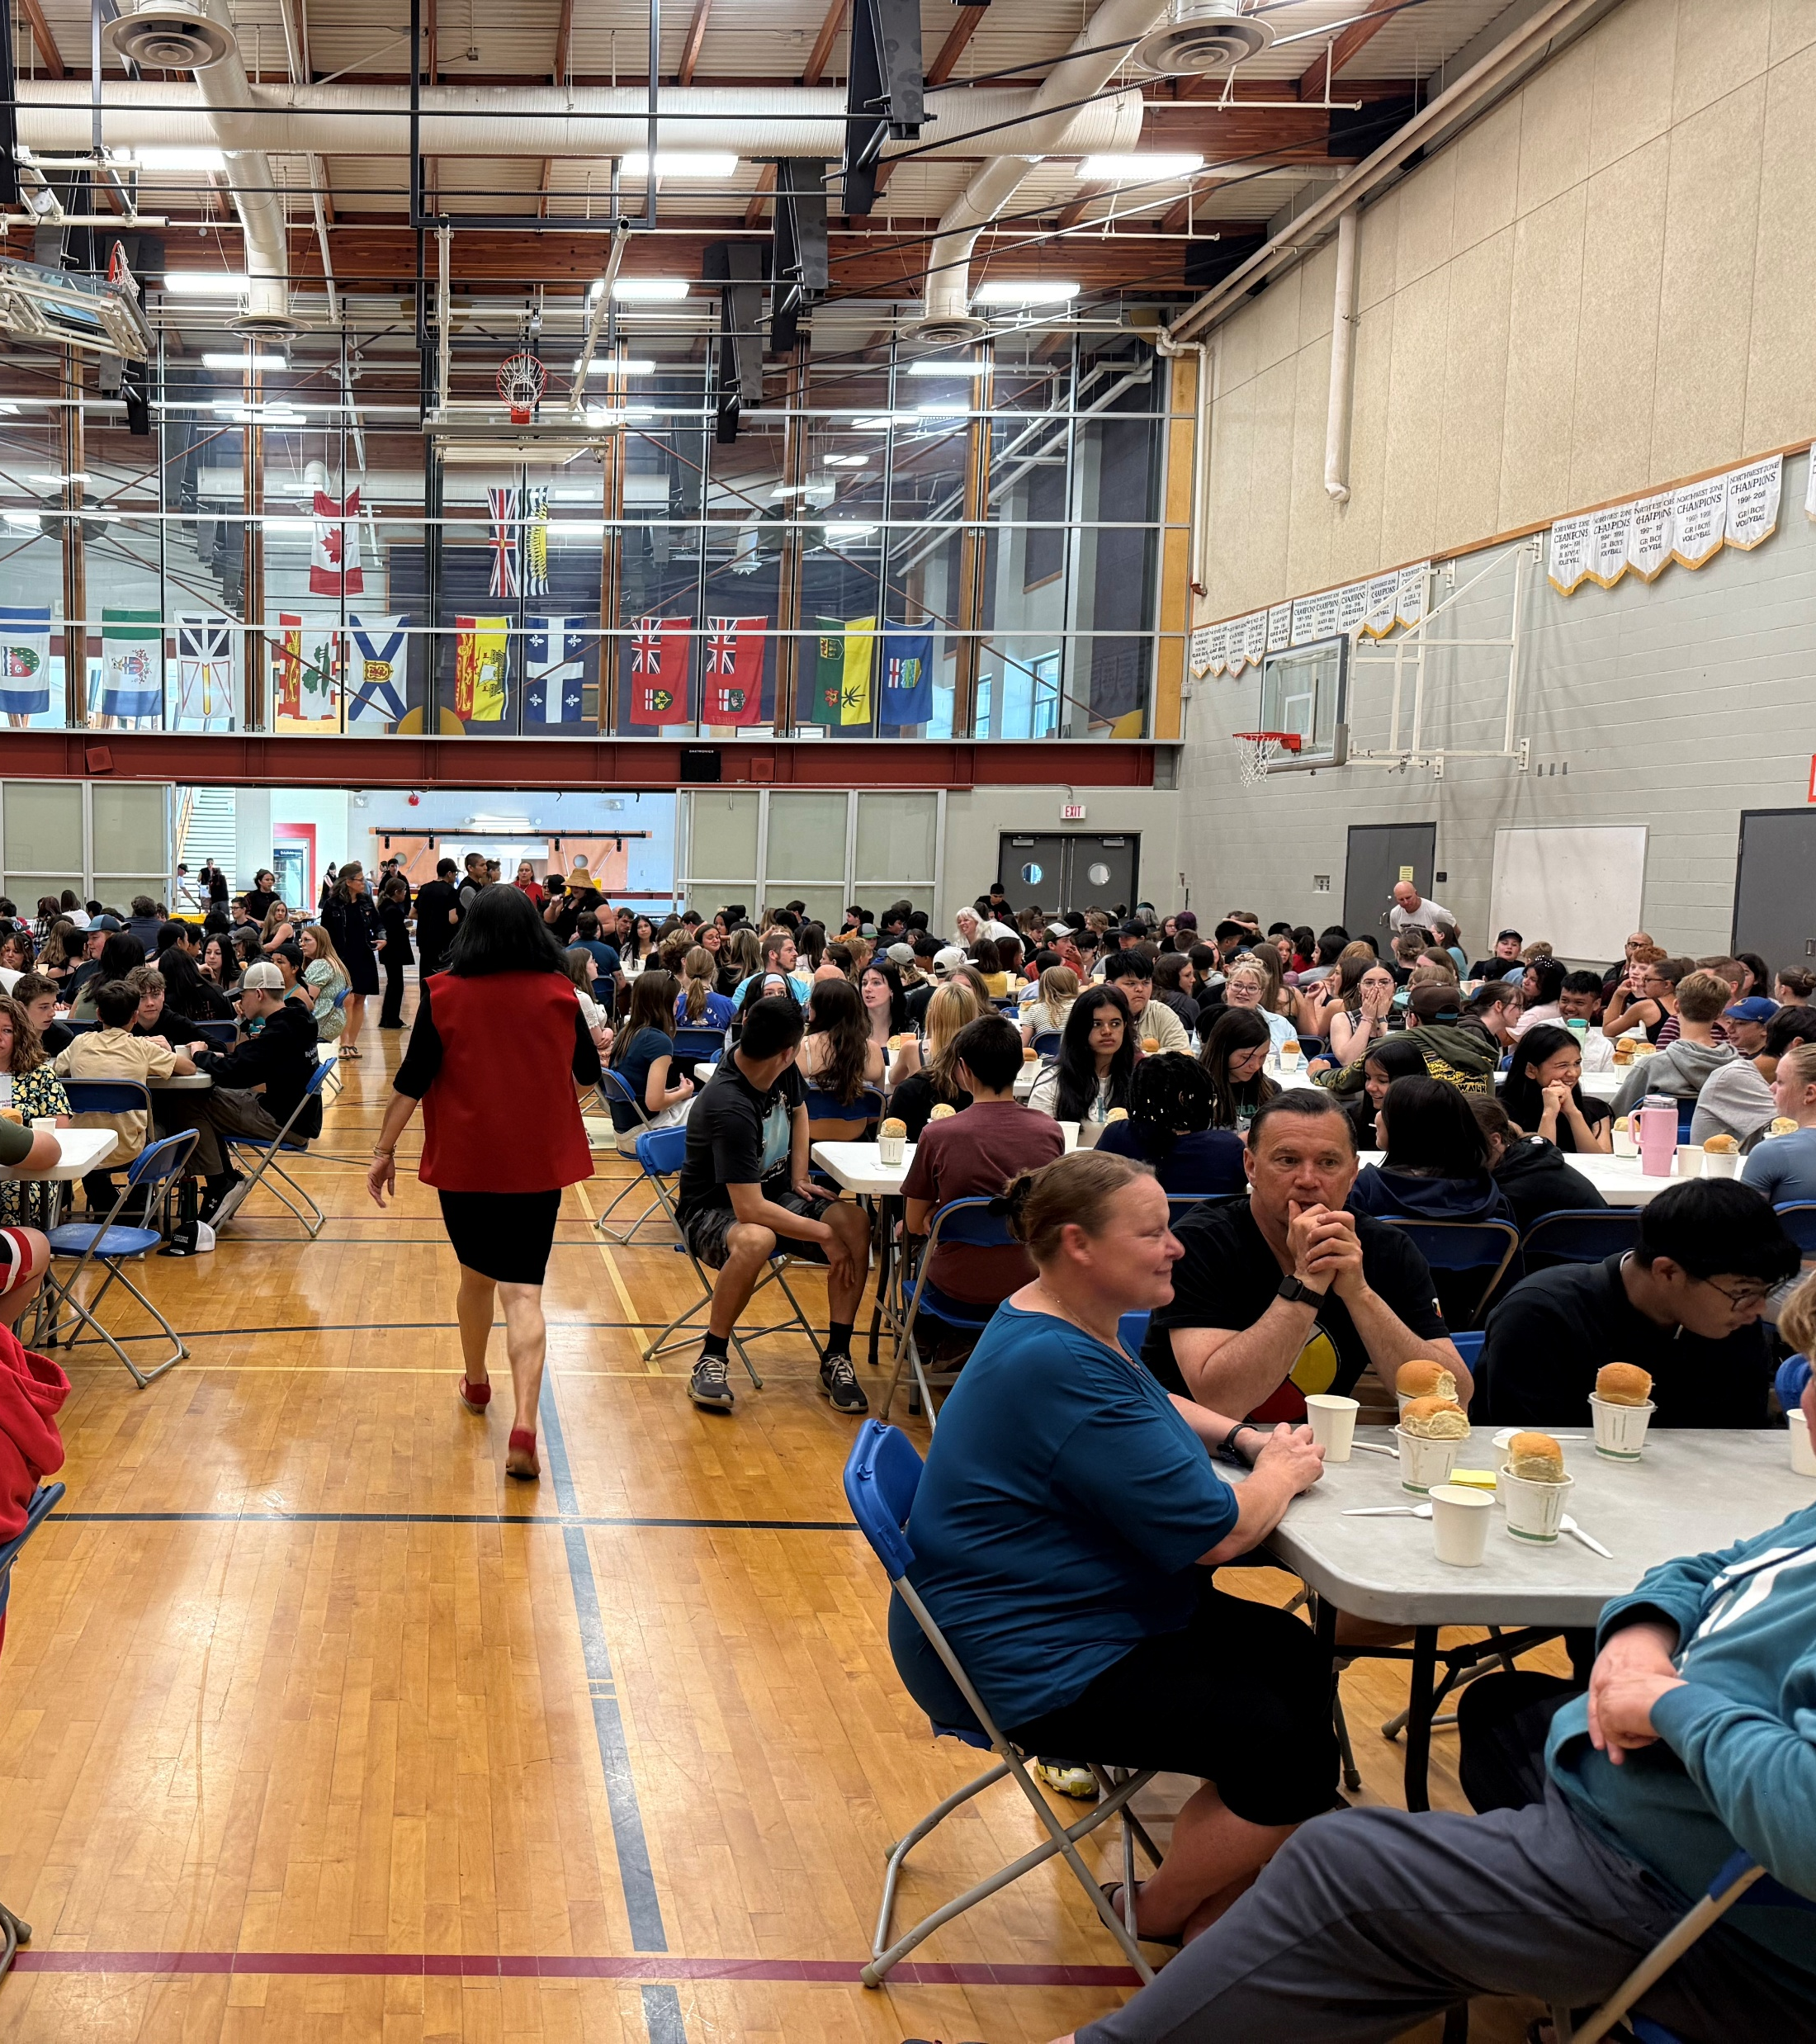
Friday advisory plans
On Fridays, students will participate in more explicit social-emotional learning and discussions
Teachers will facilitate learning, practice, and discussion about collaborative problem-solving, identity workshops, peer challenges, anxiety, mental health, sexism, what good relationships look like, and racism
They will do so through resources found and shared by the librarian, the counsellors, and the Indigenous support workers at our school
Some of this learning might be through Open Parachute and PrevNet, but it could also be more teacher- and student-led
Each class will dig into the skills and challenges specifically needed in that class, as identified by the teachers and by the students themselves in collaborative discussion
Teachers will work to build and honour student capacity for such learning and discussions, and will work to make it as relevant and hands-on as possible for the students

Slide 9
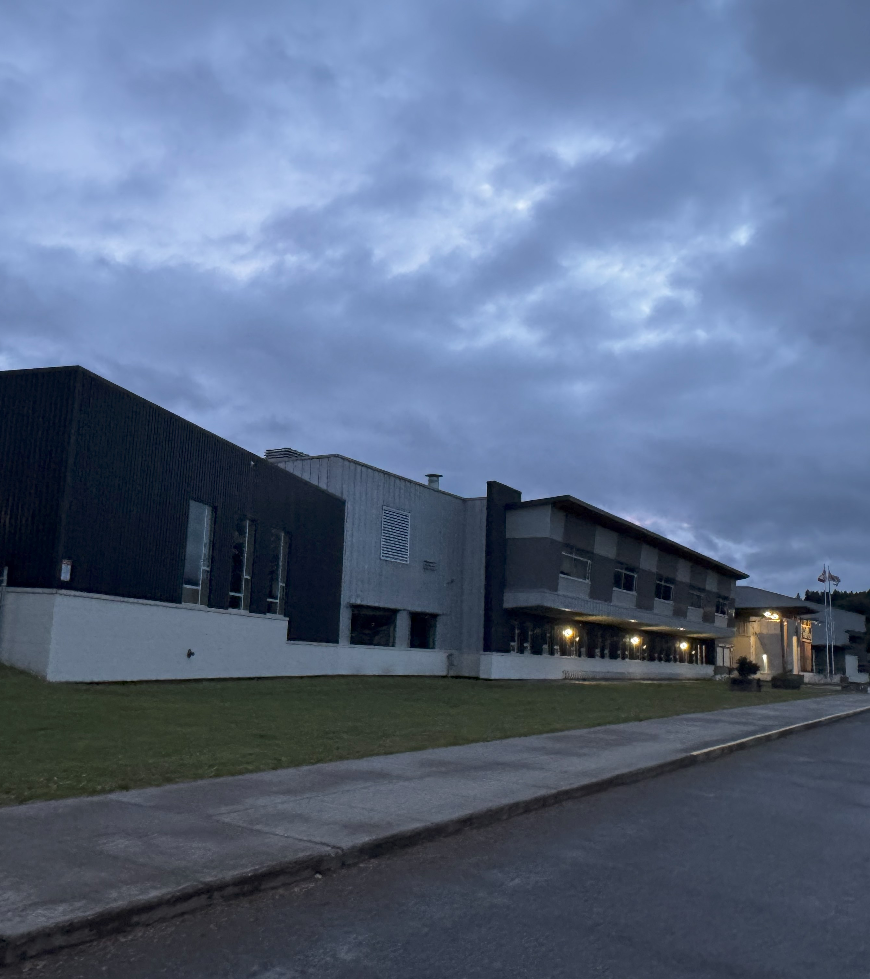
resources
All teachers, new and returning, will receive an Advisory Policy from the administration at the beginning of each year where they are given the collaborative vision of advisory, its operational setup, and a list of best practices. This will ensure that everyone gets and remains on the same page
Available resources should be shared in an advisory DropBox or SharePoint folder, both of which are automatically installed and accessible on every school computer
The librarian, counsellors, and Indigenous support workers at the school will be tasked with finding and making available resources for advisory
Available programs currently include Open Parachute, but more should be identified and shared
Teachers will also be encouraged to upload successful lessons, materials, ideas, and examples

Slide 10
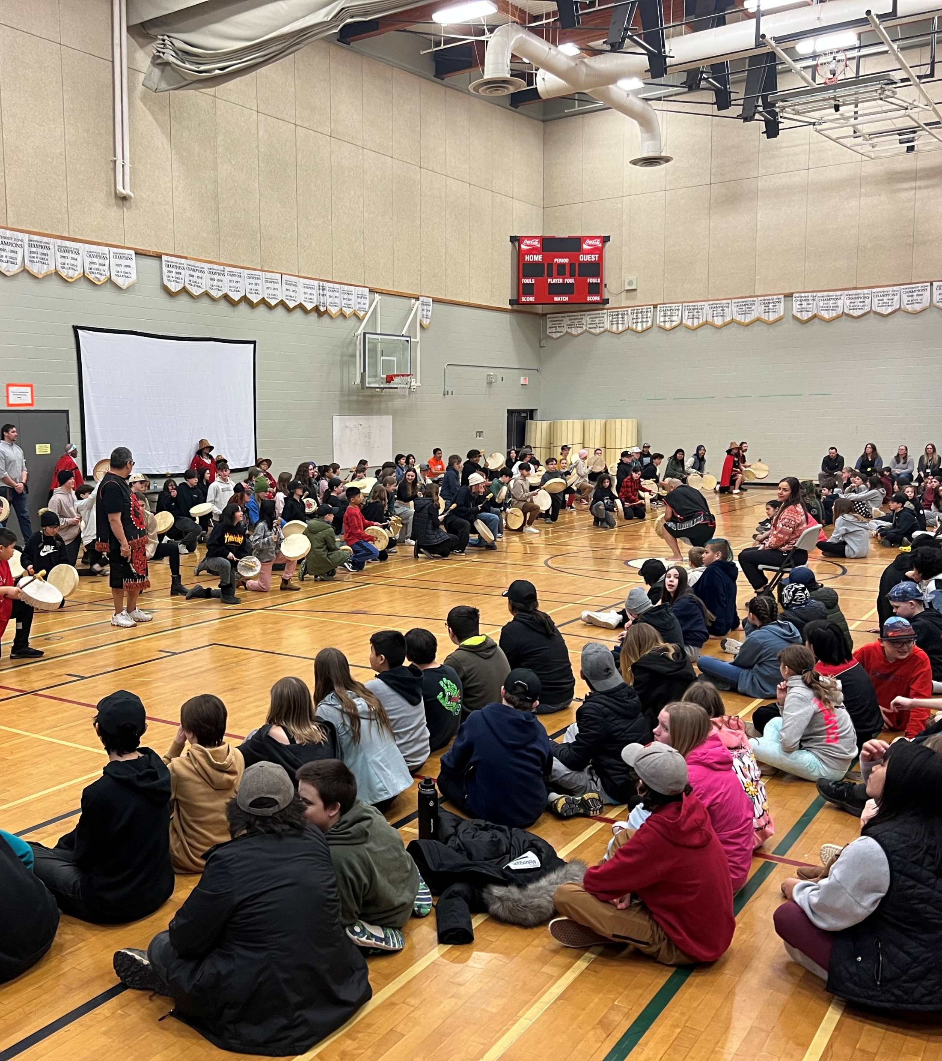
Troubleshooting challenges
Attendance should be officially reported through MyEd so that there is accountability around attendance and so that there is more control of the students’ whereabouts
Some teachers may not buy in due to general overwhelm, fatigue about trending ideas, or oppositional feelings around advisory. Teachers should be paired up or sorted into small groups to allow teachers to share ideas, support one another, and gently hold one another accountable in enacting the new vision
The counsellors should not have their own advisory classes (as they do now), but should support and advise teachers in implementing social-emotional learning
The counsellors can troubleshoot challenges with students, pulling them aside to work issues out with them, and mediating peer challenges

Slide 11
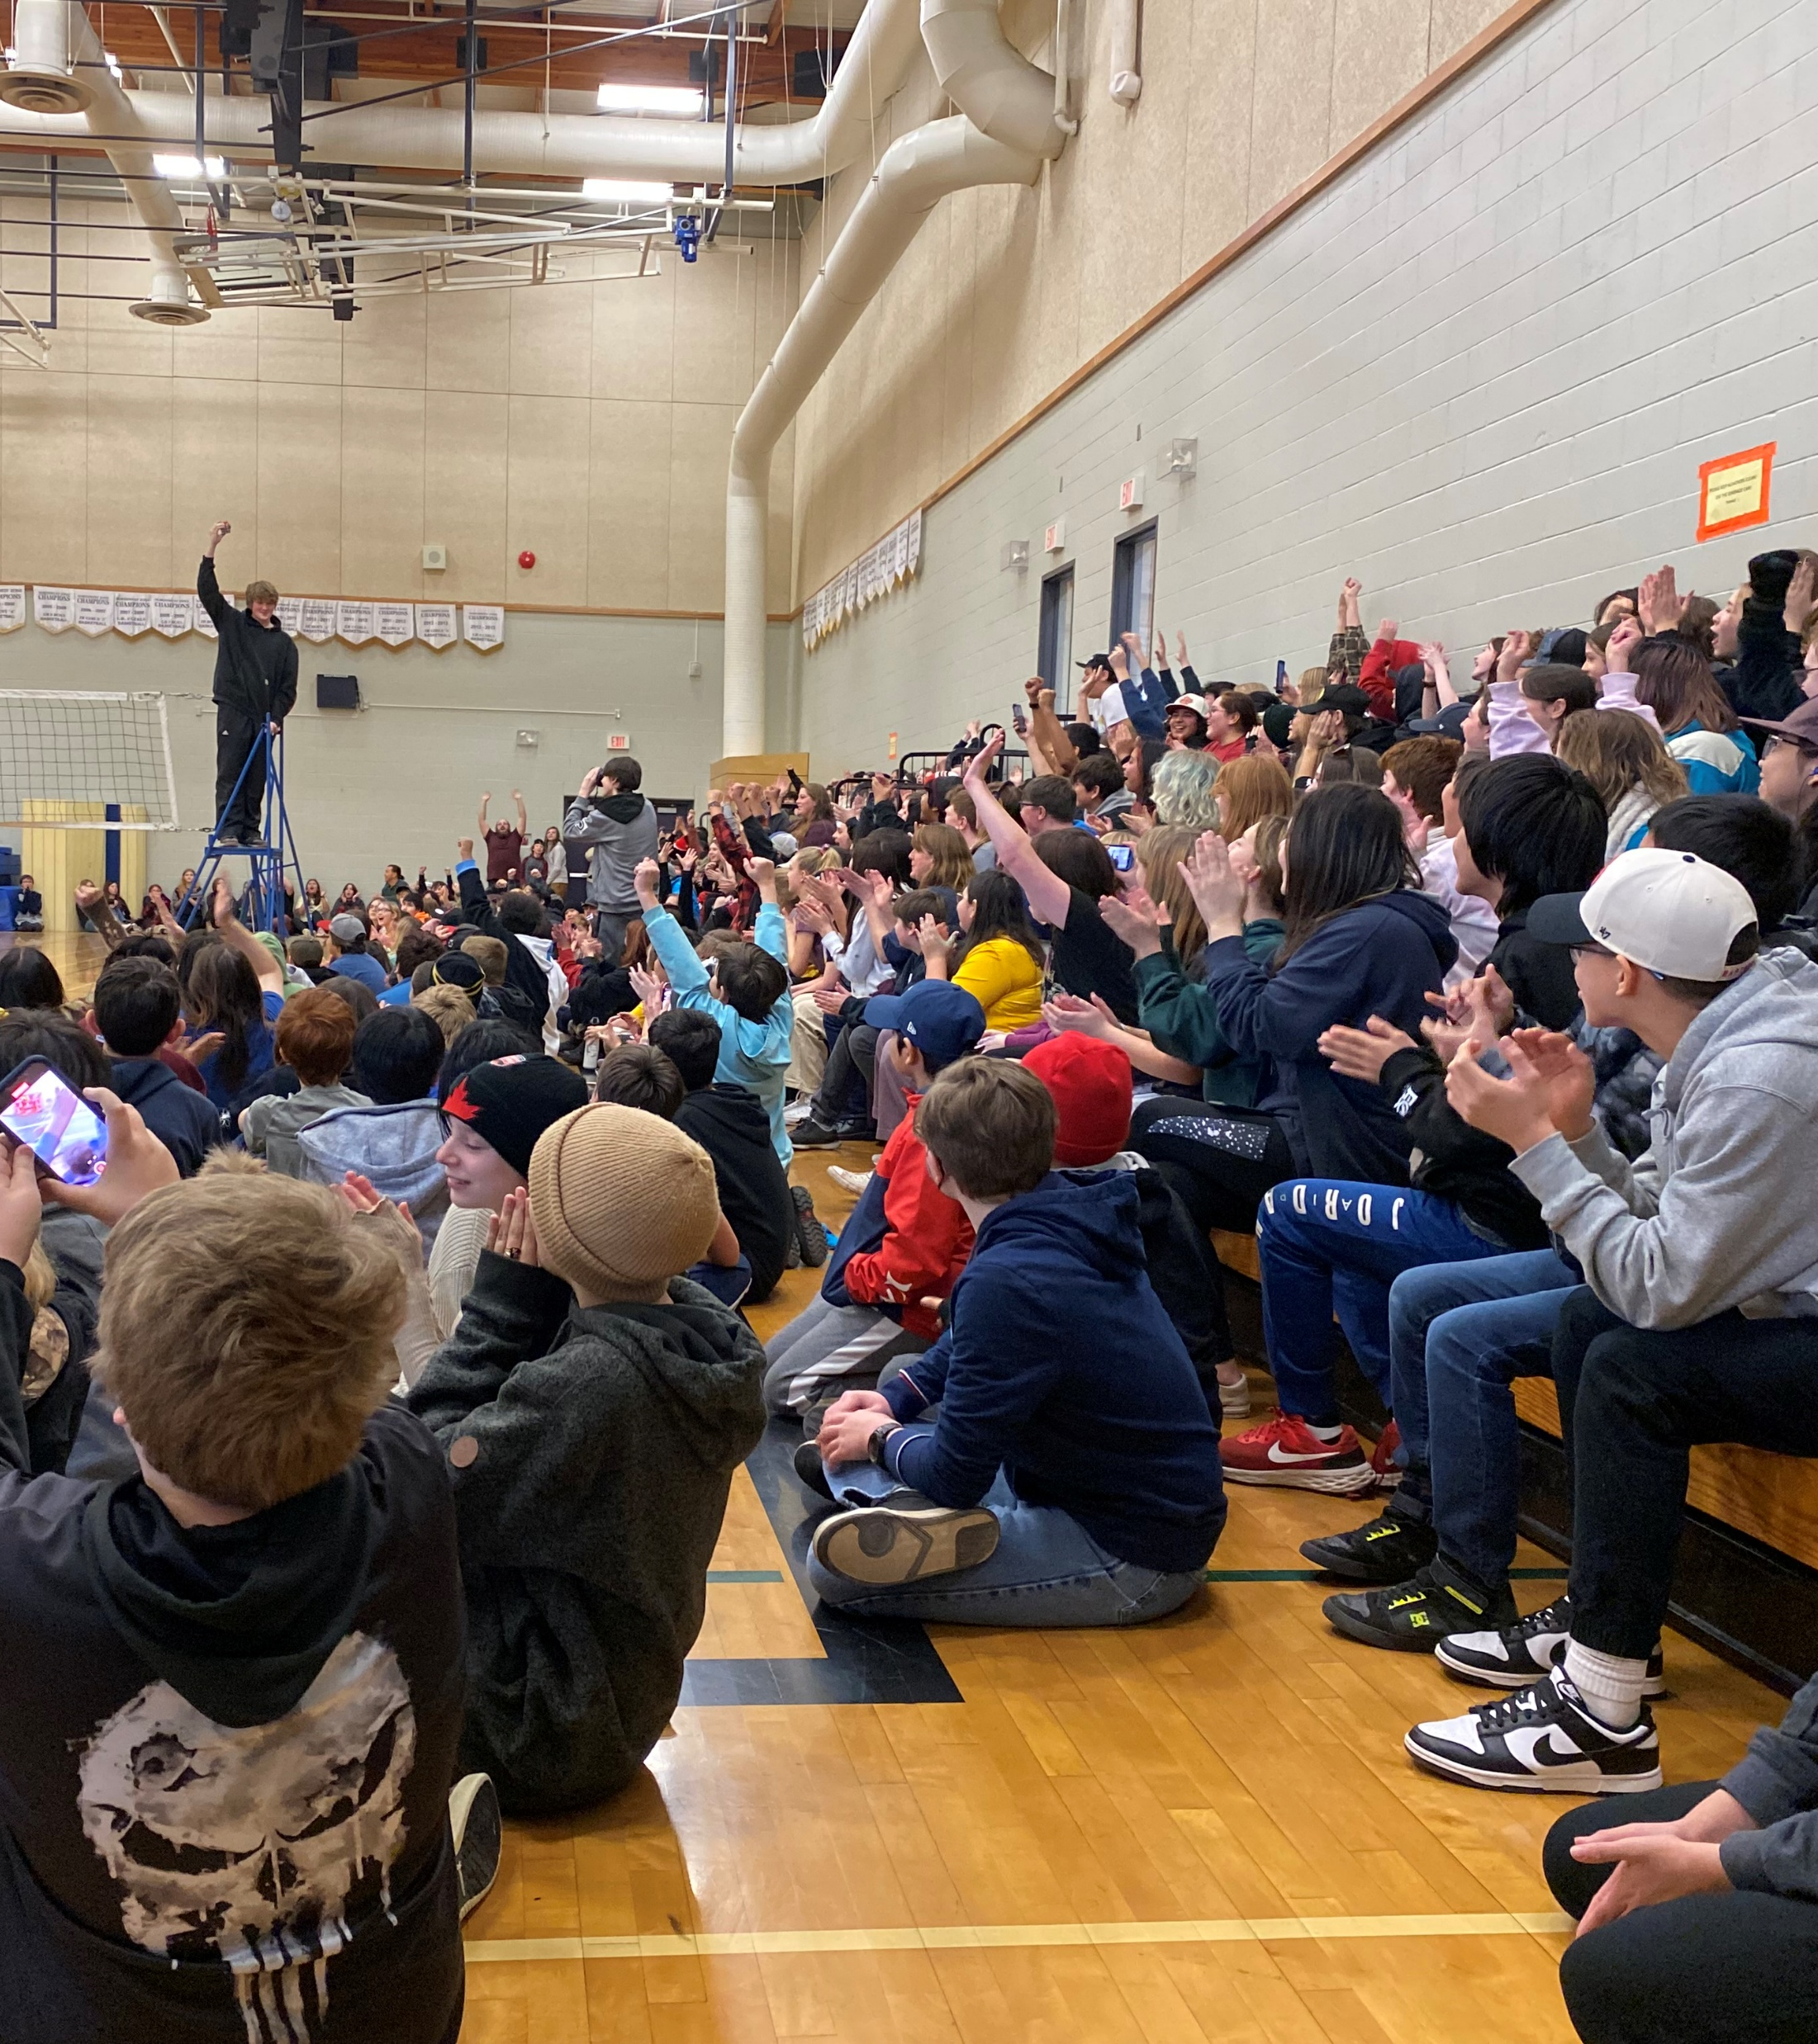
review
At the end of the year, spend time together as an entire school staff (perhaps with a school-catered lunch) to review what went well, what could have been improved, and where we want to go in the future with advisory
Work together to tweak, update, and revise our school-wide vision for advisory
Share and celebrate successes
Troubleshoot challenges in small working groups, then report out to the entire staff
Ensure that everyone’s perspective is valued and is shared and listened to in circle
Make plans together for next year
Determine together what resources, supplies, and schedules are needed for next year

